Slide 1
Measurement of Hypertriton at Fixed Target
Xiaohai jin
Feb 10 2019

Slide 2
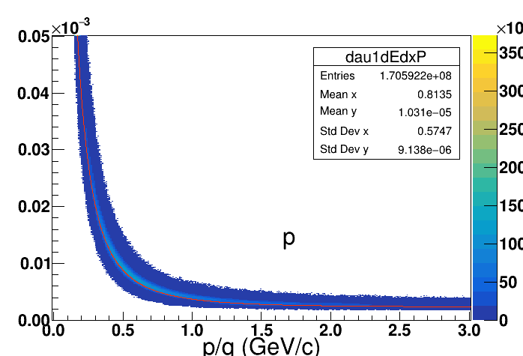
Proton

Slide 3
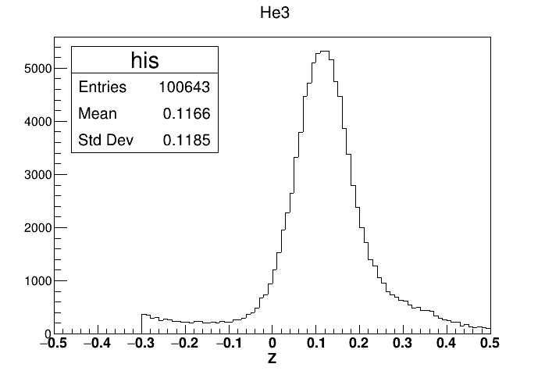
Helium3

Slide 4
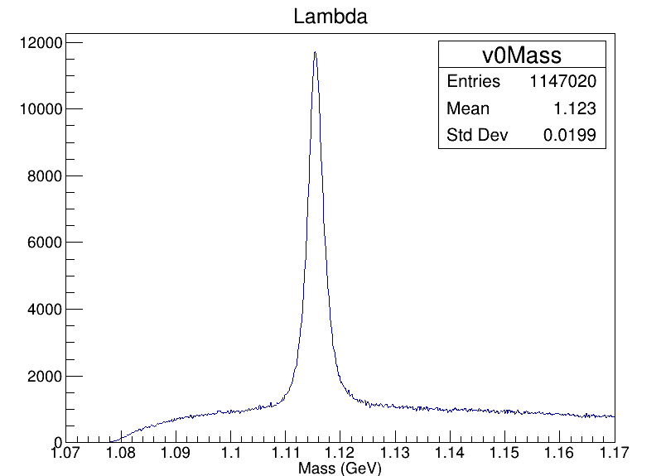
Lambda

Slide 5
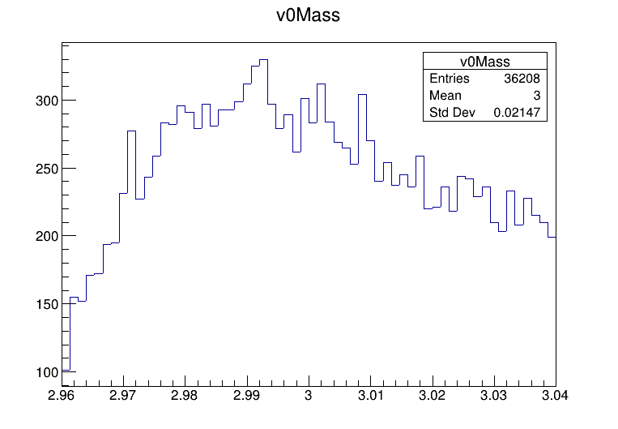
H3L Mass

Slide 6
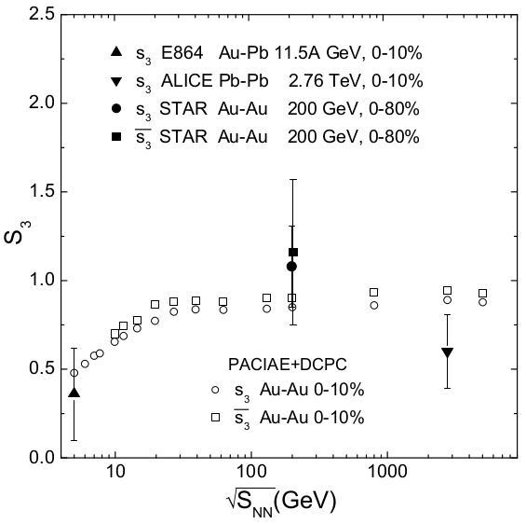
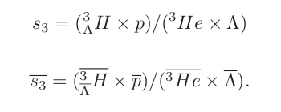
strangeness population factor
Why is there no production
of hypertriton?

Slide 7
